Slide 1

Data Model / Database Implementation (continued)
Jeffery S. Horsburgh
Hydroinformatics
Fall 2016
This work was funded by National Science Foundation Grants EPS 1135482 and EPS 1208732

Slide 2
Assignment 3 Database Implementation and Loading Data
GOAL: Organize and load observational data for a continuous water quality monitoring site from the GAMUT network to an ODM database in MySQL.
Alternative: Use your data model design from Assignment 2

Slide 3
What You Will Do for the Assignment
Create a blank ODM database in MySQL
Load Site, Variable, Method, and Source metadata plus sensor observations using MySQL Workbench
Visualize and explore the data using the ODM Tools Python software
Evaluate ODM as a data management tool for sensor data from the Logan River GAMUT sites

Slide 4
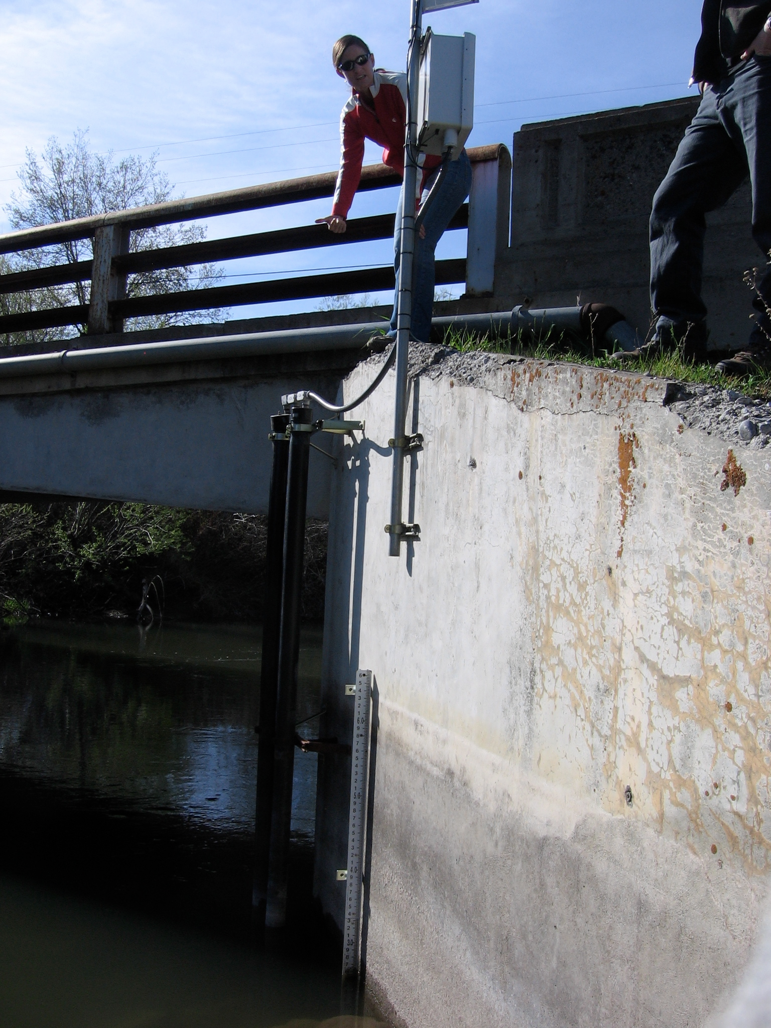
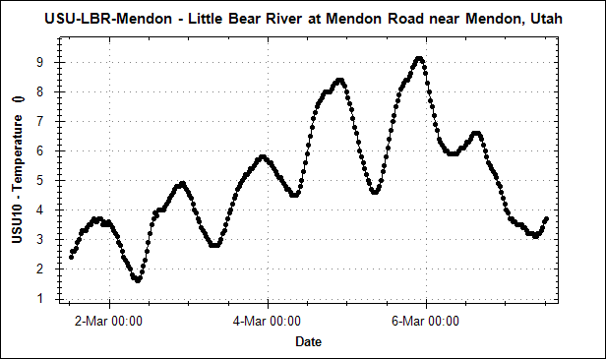
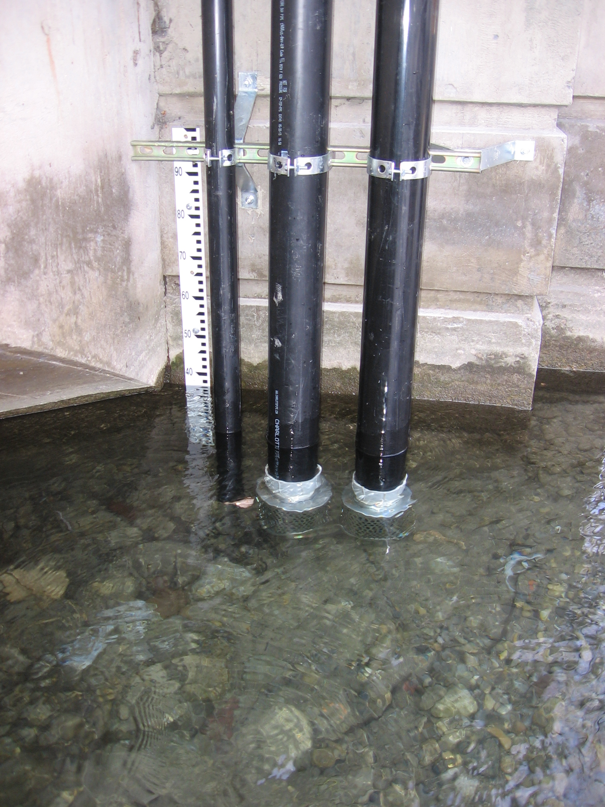
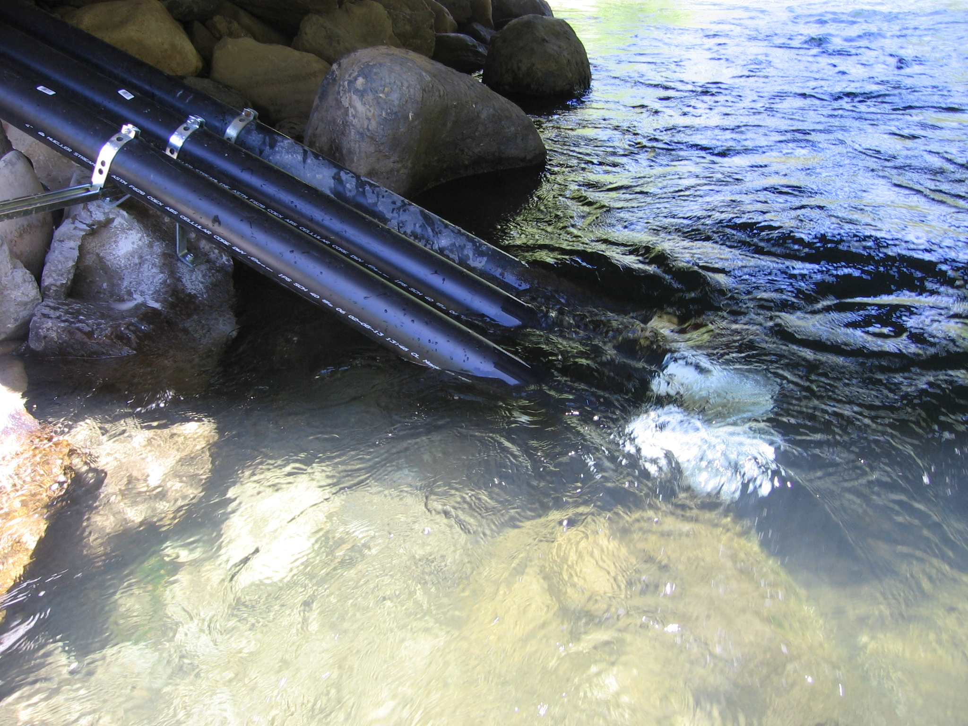

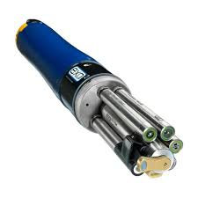
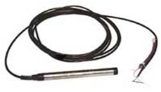
The Data You Will be Using Logan River GAMUT Data
Multiple Monitoring Sites
1 or More Time Series Per Sensor
3 Different Watersheds
Multiple Sensors at Each Site

Slide 5
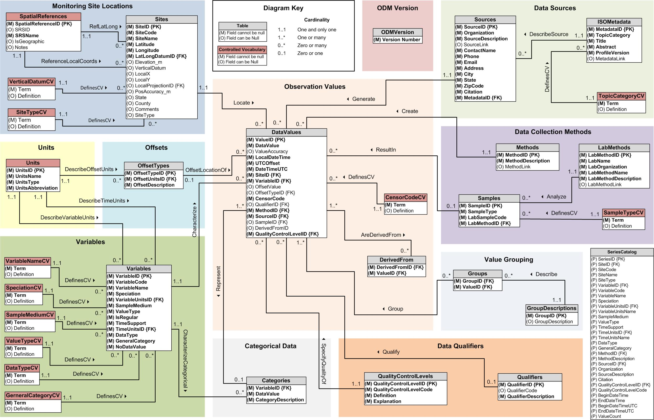
ODM Data Loading Strategy

Slide 6
Why are we using ODM?
ODM is an established data model for these types of data
ODM has a set of associated software tools
ODM enables us as instructors to write additional exercises that build on what you are doing

Slide 7
DEMO: Create a Blank ODM Database in MySQL
Create a new schema in MySQL
Download the SQL script to create the empty ODM database
Open the SQL script in MySQL Workbench
Execute the SQL script to create the ODM structure within the empty schema

Slide 8
DEMO: Load Table-Based Data to ODM in MySQL
Format data tables as comma separated values files
Script the data file upload using MySQL’s LOAD DATA LOCAL INFILE command
Execute script to load data

Slide 9
Warning!
Watch your line ending characters!
Default for Windows: '\r\n'
Default for Mac: '\n'
LOAD DATA LOCAL INFILE '/Users/JeffHorsburgh/Desktop/Assignment3Data/sites.csv'
INTO TABLE sites
FIELDS TERMINATED BY ','
ENCLOSED BY '"'
LINES TERMINATED BY '\r\n'
IGNORE 1 LINES
(SiteCode,SiteName,Latitude,Longitude,LatLongDatumID,Elevation_m,VerticalDatum,LocalX,
LocalY,LocalProjectionID,PosAccuracy_m,State,County,Comments,SiteType);

Slide 10
Load Data into the Database
Is there an easier way?????
MySQL includes simple file-based data loading through MySQL Workbench
BUT – your input file MUST be exactly like the table you are inserting data into – I’ve found it difficult to use

Slide 11
Visualize Data Using ODM Tools
Connect to the database using a client software application
Visualize and manage data using the software tools

Slide 12
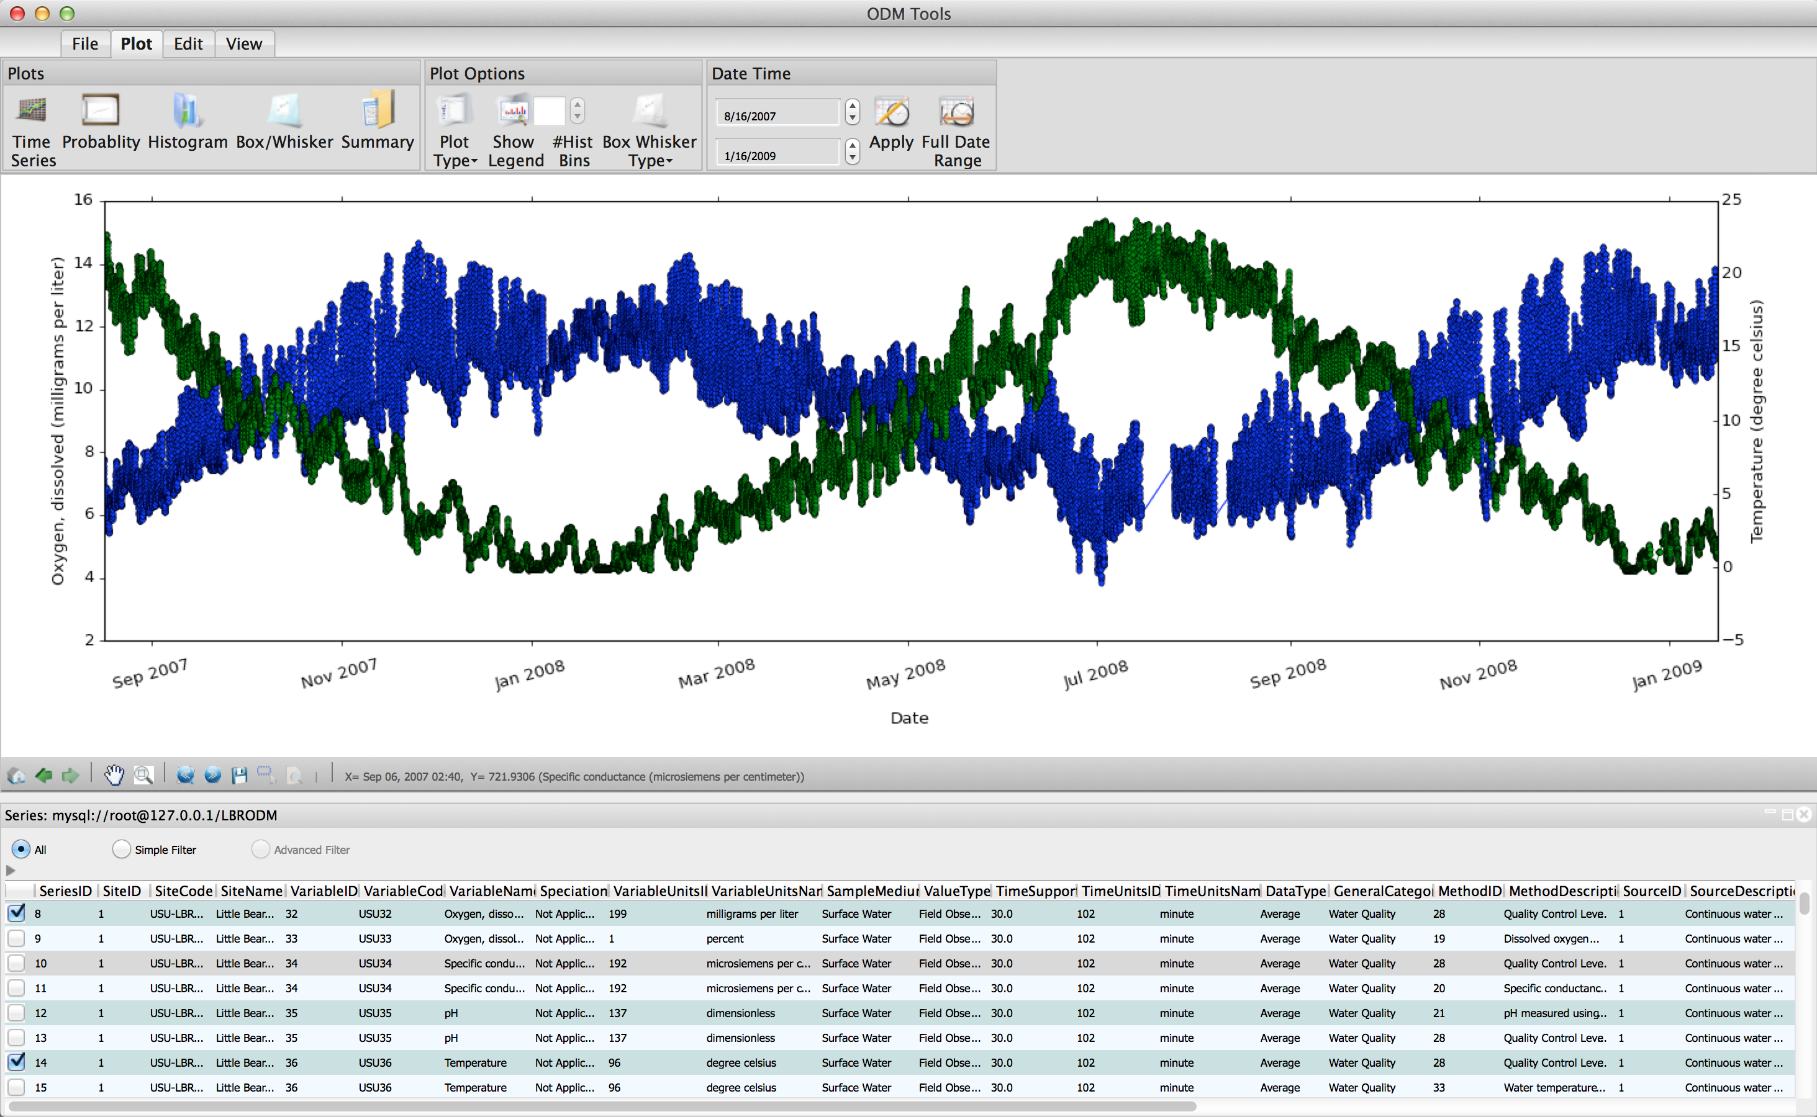
DEMO: ODM Tools Python

Slide 13
What You Need to do Next
Create additional ‘datavalues.csv’ files
One file for each column of data
Excel might be a good option
Structure them to be the same as the one I gave you
Make sure you get the foreign key IDs correct!
Save as a CSV file
Write script to load your CSV files
Don’t forget line endings!

